Slide 1
Cloud9 Efficient Traffic Network - An EPN system
Team Members:
Ho Kok Loon Lee Tin Onn Vincent Leung Choong Yue Lin Lee Wai Tong Peter Lei Jun

Slide 2
Agenda
Introduction
EPN System Analysis
EPN Design
EPN Evaluation & Conclusion
Demo & QAs

Slide 3
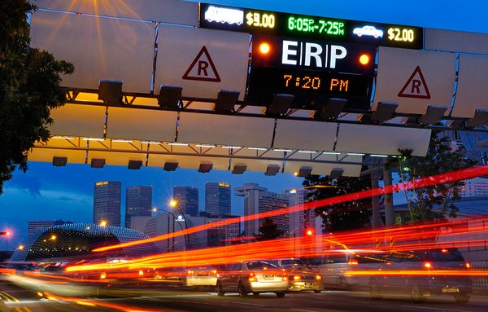
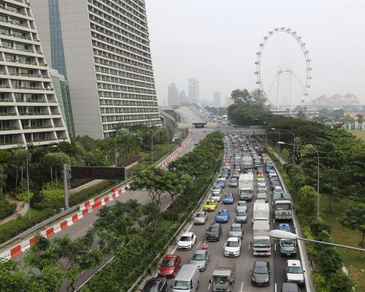
Introduction
Traffic jams
detrimental to health and environment of residents
affect the productivity of a country
take too long on the road
…

Slide 4
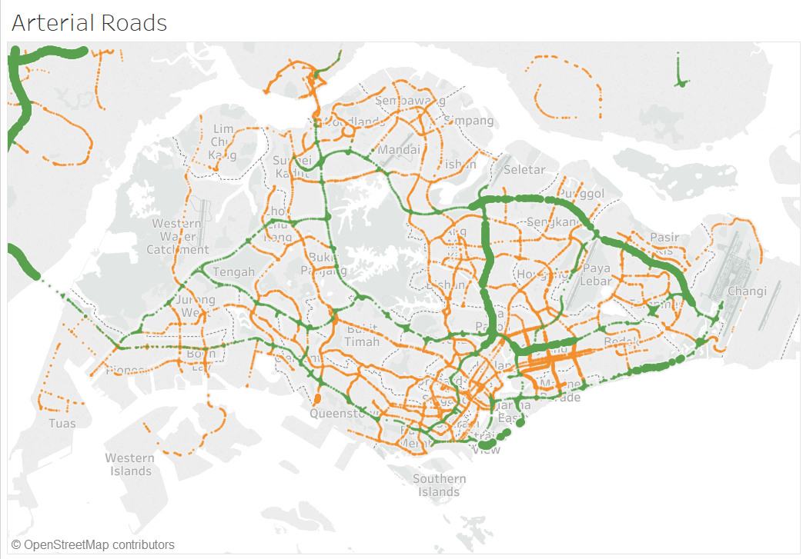
Our solution – an EPN system
EPN: event/message driven system. E.g. accidents, bad weather
By gathering real time traffic data from LTA, weather data from NEA and geospatial data, the system detects the event pattern, analyses, filters and aggregates the data.. And then helps drivers to make decisions.
Weather conditions
Temporal Analysis
Spatial
Accidents
A CEP system

Slide 5
Event Processing Network triggers the messages at each of the individual arterial roads so as to improve road conditions at major expressways.
Producer
Consumer
EPA1: Pattern - Temporal
Output
message = “Lesser traffic” at road
message = “slowdown” at road
EP1
Estimated travel increase
Estimated travel decrease
Estimated Travel Time
EP2
EPA2: Pattern - Temporal
message =“Major Jam at RoadName” exit at AlternativeRoad
message = “Traffic building at” Roadname. “exit at” AlternativeRoad
road category = C/B &
previous speed band = 2 &
current speed band = 1
road category = C/B &
previous speed band = 3 &
current speed band = 2
Traffic Speed Bands
Channel1
Output
EC1
Not Selected
Expressway Monitoring and Advisory System (EMAS)
EPA3: Pattern - Spatial
Output
EP3
road category = C/B &
current speed band = 2/3 &
Forecast in area =HG/HR/HS/HT
message = “Heavy Rain expect in” Area. Drive with caution”
NEA 2-hr NowCast
Not Selected
Singapore
Geospatial
Database
EP4
EPA4: Filter
message = “Heavy rain in” Area. “Drive with caution”
MSS Current Rainfall
Rainfall > 7.5mm in last 30 minutes
EP5
message = “Heavy Rain expected”
NEA Heavy Rain Warning
Event Processing Network triggers the necessary assistance needed if there is an accident on the road.
EP6
Filter In
Traffic Incidents
EPA5: Filter
Type = accident/vehicle breakdown/unattended vehicle
Filter Out
message = Traffic accident at.
message = roadworks at
Non-filterable

Slide 6
EPN Evaluation & Conclusion
Event types
Capture traffic data(LTA), weather data near real time
Event Pattern detection
Filter, aggerate and combine the events with geographic location, average speed
Alert drivers and give suggestions
Event Blocks
Event Type
Event Producer
Event Consumer
Event Processing Agent
Channel
Context
Global State Element

Slide 7

Demo

Slide 8
Lessons Learned & Future Improvements
It is important to analyze data from various data source;
Speedband granularity range could be narrowed down;
Different data sources hold different timestamps which cannot linked together well. This needs more processes and analysis to be more accurate;
The output alerts could be sent to users based on their geographic location;
Could apply current business intelligence products(e.g. Tibco) as well as database system to enhance the productivity and performance.

Slide 9

Q&As

